Slide 1
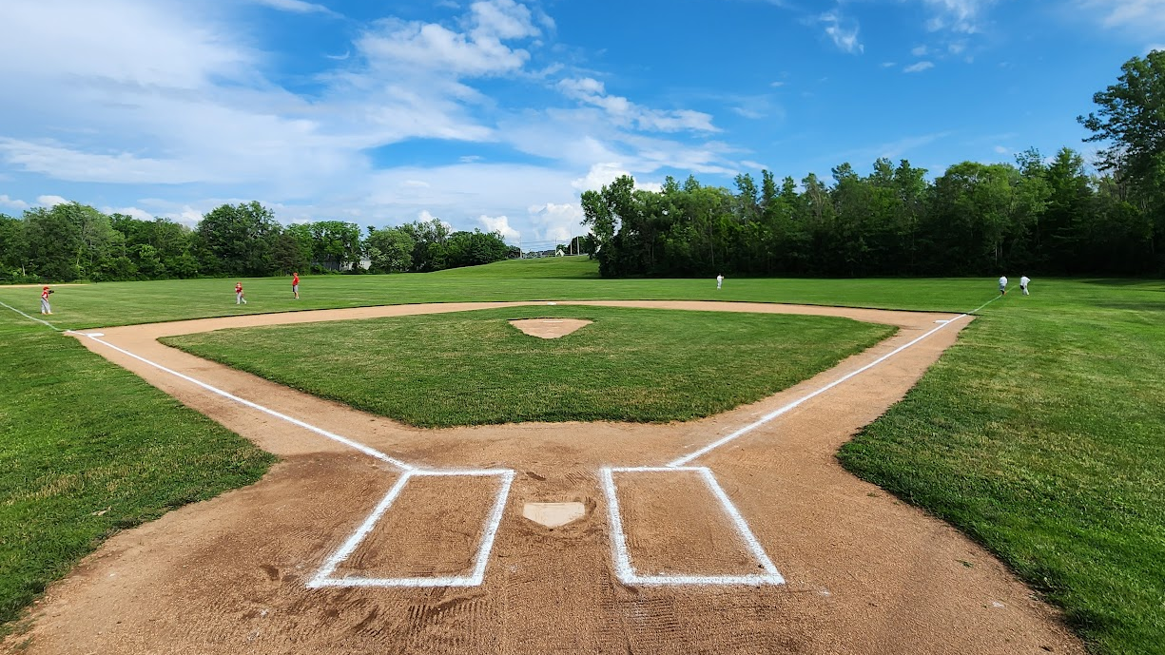

COACH GUIDE
2026
Web: Spencerportjuniorbaseball.com Email: contact@spencerportjuniorbaseball.com

Slide 2

Board of Directors Directory
2
Baseball | Board Member | Primary Email Address
Director 4-8yr. | Bryan Murphy | baseball-director4-8@spencerportjuniorbaseball.com
Coordinator T-Ball, 4-6yrs. | Craig Neal | T-ball@spencerportjuniorbaseball.com
Coordinator Juniors 7-8yr. | Todd Wingrove
Director 9-17yr. | Open | baseball-director9-17@spencerportjuniorbaseball.com
Coordinator Minors 9-10yr. | Open (Steve Webster interim) | Stephen.webster@spencerportjuniorbaseball.com
Coordinator Majors 11-12yr. | Kevin Heagerty | baseball-ponies@spencerportjuniorbaseball.com
Coordinator Juniors/Seniors 13-17yr. | Scott Owens | baseball-ponies@spencerportjuniorbaseball.com
Executive | Board Member | Primary Email Address
Commissioner | Steve Webster | commissioner@spencerportjuniorbaseball.com
Treasurer | Scott Webster | treasurer@spencerportjuniorbaseball.com
Community Engagement Vice President | Justin Reed | community@spencerportjuniorbaseball.com
Baseball Operations Vice President | Steve Webster | baseball-operations@spencerportjuniorbaseball.com
Softball Operations Vice President | Heather Riexinger | softball-operations@spencerportjuniorbaseball.com
Support | Board Member | Primary Email Address
Purchasing Coordinator | OPEN
Event Coordinator | OPEN
Umpire Coordinator | Greg Macomber | umpire-coordinator@spencerportjuniorbaseball.com
Technology Coordinator | Bryan Murphy | webmaster@spencerportjuniorbaseball.com
Social Media Content | Leah D'Agostino | leah.dagostino@spencerportjuniorbaseball.com
Fundraising | Justin Reed/Joe Cutaia | joe.cutaia@spencerportjuniorbaseball.com
Softball | Board Member | Primary Email Address
Coordinator 5-8yr. | Heather Riexinger | softball-rookies@spencerportjuniorbaseball.com
Coordinator Minors 9-10yr. | Kevin Heagerty | softball-minors@spencerportjuniorbaseball.com
Coordinator Majors, Travel 11-15yr. | Heather Riexinger | softball-majors@spencerportjuniorbaseball.com

Slide 3

Volunteer Requirements
All League Volunteers are required to complete a background check
  Utilize the Little League/JDP Background screening system or similar solution
  A secured Social Security number portal. Direct input by submitters
Comply with the “Code of Conduct”, coaches, parents, players, board members
Complete online Abuse Awareness, First Aid Safety Modules
Social Media Code of Conduct
Coaches will monitor player and parent “Code of Conduct”
League will use the guidelines, and regulators as identified in the by-laws
3

Slide 4
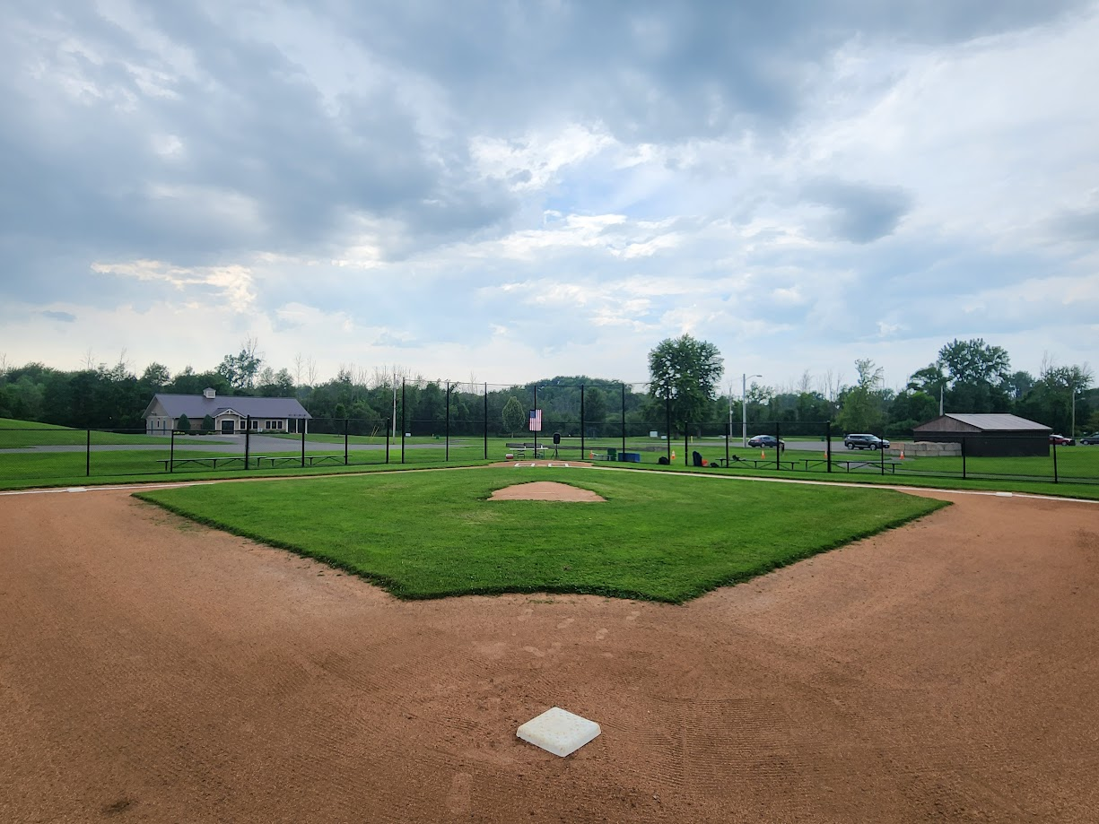
Player Safety is THE PRIORITY
Professional interaction. You are the face of the Organization
Setup a meet and greet w/ your players and families at first practice to set clear expectations for parents
Understand any medical issues or concerns in a private discussion with a legal guardian
Engage your players immediately and in the open.
Never discipline in the middle of a competition or with a public announcement
You’re there to coach….not yell.
Be a role model
Return all equipment and base plugs to their original location. Your field maintenance staff will love you.
Expectations
of Coaches
Make it fun for all
Huge responsibility
Rewarding
How would you like to be remembered

Slide 5
What you need to know…..
Pre-Game/Practice
      A fully stocked medical kit is required at all practices and games
Field Inspection: Check fields for hazards holes and debris before field use
Equipment Check: Inspect all equipment before uses
All Equipment must meet the League’s Requirements
Return any faulty items to the League Representative for replacement
Approved Coaches Only:** Only League-Approved adults are allowed to assist with coaching
In-Game/Practice
Teach athletes safe bat storage and handling
Head Injury Protocol:** Remove any athlete suspected of a head injury notify their parents immediately and follow up with family within the next 24 hrs.
Post-Game/Practice
Injury Reporting:** Complete the Incident/Injury Tracking Report within 24-48 hours for first-aid incidents
5

Slide 6

What you need to know…..
WEATHER COSIDERATIONS
School/Town during the week generally let’s SJB&S know by 3pm whether fields are going to be closed
League Coordinators will communicate w/ head coaches to discuss the cancelling of games/practices
                Do not pre-emptively cancel games or practice without a discussion/approval of league coordinator
6

Slide 7

What you need to know…..
Environmental Considerations
      Thunder/Lightning Policy
Practices/Games will be suspended upon sight of any lightning or sound of any thunder immediately for at least 30 minutes.
Players/coaches are to seek safe shelter (vehicles, covered dugouts) during the delay.
**Each clap of thunder or strike of lightning resets the 30-minute clock
7

Slide 8


What you need to know…..
Environmental Considerations
Cold Weather Guidelines
      Coach discretion within reason; > 45 ºF
      Consider “Real Feel” Temperature
      Peak performance thrives > 50 ºF
      Warm Weather Guidelines
      Use NYSPHSAA Heat index procedures
      Consideration for air temperature and relative humidity
8

Slide 9

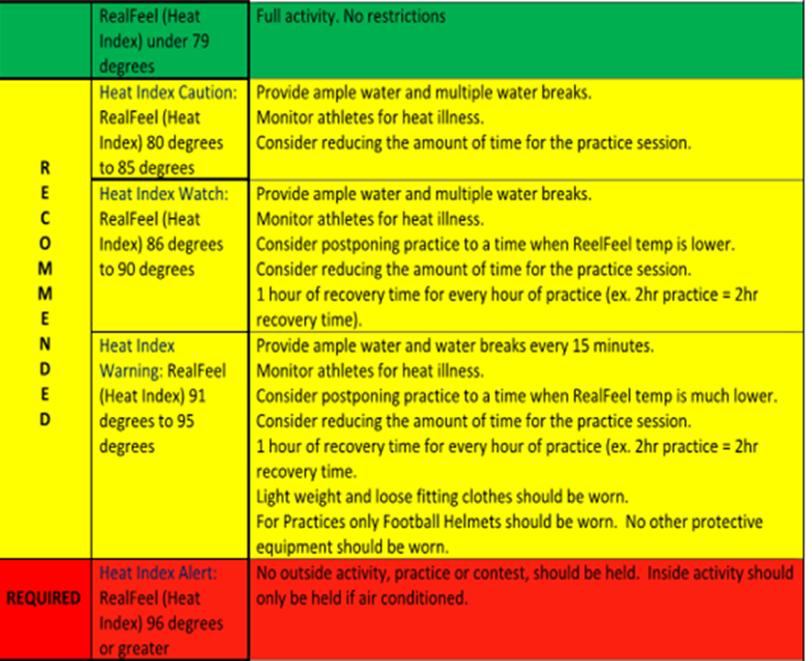
NYSPHSAA Guidelines
Three zones determine the recommended guidelines
9

Slide 10
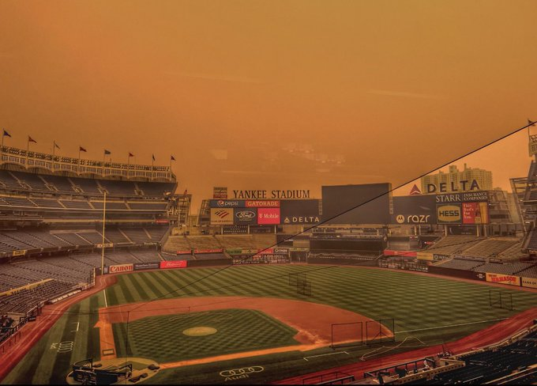
What you need to know…..
Environmental Considerations
Air Quality
      In the event of significant air quality concerns (e.g. wildfire smoke, smog, etc.), the determination to play may be determined by Spencerport schools, Ogden Parks and Rec, and/or Spencerport Junior Baseball & Softball
      Players/Spectators with conditions that may be aggravated by poor air quality may be advised to stay home
      Parents always have the option to keep their child home, even if the determination has been made to play
10

Slide 11
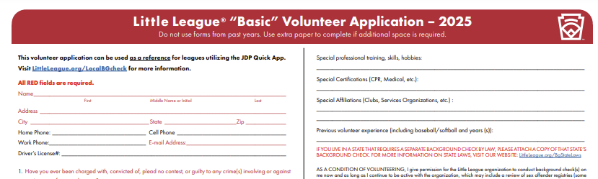

INJURY GUIDELINES, TRAINING
&
REPORTING REQUIREMENTS
All injuries need to be reported to League Coordinators immediately after the conclusion of the contest by the Manager
All League Coordinators are required to report within 24 hours of the incident to the league safety coordinator
The form must be completed in its entirety. Forms can be downloaded from the Littleleague.org website
All forms must be signed by the Manager who submitted the form
All Coaches are expected to follow up with the family within 48 hours injury

Slide 12

What you need to know…..
AED/CPR
Automated External Defibrillators
      SJB&S is developing a plan to have AED’s available at field locations for the 2026 season
        Spencerport Schools, Pineway Ponds, American Legion
      Plan will include
        At least 1 AED/CPR trained volunteer at each practice/game
        Notification of location of each AED
        Monthly maintenance check by SJB Board Member
12

Slide 13
Website & Technology
Web: Spencerportjuniorbaseball.com Email: contact@spencerportjuniorbaseball.com

Slide 14



All Background Checks….
  For ALL volunteers interacting with players
  Are required by our Partners (School, Town of Ogden)
  Follow Little League & MCBR Requirements
League Player Registration Data or Player Roster Data and Coach and Manager
  Data must be submitted via SJB website and/or the Little League Data Center at www.LittleLeague.org (Softball, Majors Baseball Little League Program Only).

Slide 15
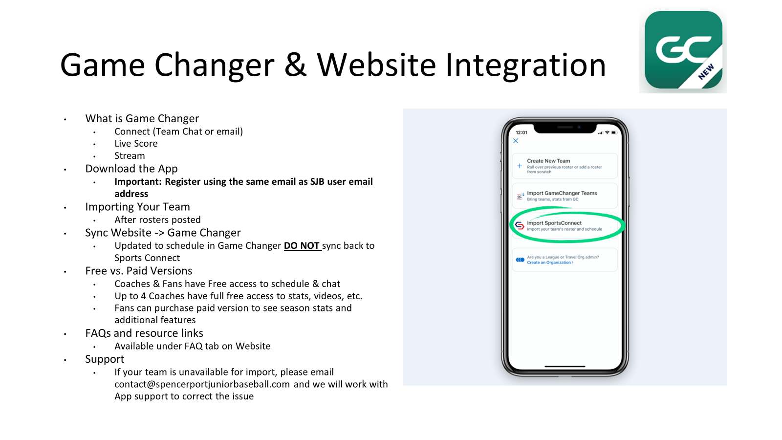

Slide 16
Health & Safety
Web: Spencerportjuniorbaseball.com Email: contact@spencerportjuniorbaseball.com

Slide 17

First Aid
Sprains/Strains
Rest, Ice, compression, elevation
Fracture/Dislocation
Immobilize the area using a splint or sling Seek medical attention
If you suspect a broken bone in the neck or back, help them stay as still as possible
Cuts/Scrapes
Clean wound, apply pressure with bandage/gauze, apply bandage
17

Slide 18
Emergency Contact Information
      Emergency Phone Number: 911
      Ogden Police Dept: 585.617.6131
      Ogden Fire Dept: 585.352.6115
      League Safety Officer: Tony Pisa 585.259.0387
      SJB Commissioner: Tony Pisa 585.259.0387
      Vice President of Softball Operations: Heather Riexinger
      Vice President of Baseball Operations: Stephen Webster
18

Slide 19
Appendix
Web: Spencerportjuniorbaseball.com Email: contact@spencerportjuniorbaseball.com

Slide 20
Safety and Compliance Cheat Sheet To be stored in Team’s Medical Kit throughout the season
Important Practice/Game-Day Safety Top 10: Safety is Priority #1. Coaches must ensure fully stocked medical kit is available at all practices and games; if you need replacement ice packs, band-aids, etc., please contact League Coordinator for replacements. Coaches must thoroughly inspect all fields prior to practices/games. Search for holes, field damage, rough or uneven spots, slippery areas, glass, rock and other debris/foreign objects. Coaches must thoroughly inspect equipment each contest; athletes must use proper bats for practices/contests; catchers’ equipment and batters’ helmets must be in good condition with no cracks, missing pieces, etc. Return faulty equipment to League President. Enforce Spencerport Junior Baseball Thunder/Lightning Policy: Immediately suspend play for 30 minutes upon sight of any lightning or sound of any thunder and seek safe shelter. Every subsequent strike of thunder/lightning restarts the 30 minute clock. Abide by SJB Heat Index Procedure when Feels Like Temperatures exceed 79 degrees. Heat Caution: 80-85 degrees; Heat Watch: 86-90 degrees; Heat warning: 91-95 degrees; Heat Alert: 96 or above. Ice should be available at all contests; bucket of ice with cool towels should be available when temperature exceeds 79 degrees. Devote practice time to teaching students how to safely slide, handle bats (no throwing after hit), and proper use of safety equipment. Only League-Approved adults may assist with coaching responsibilities. Complete SJB Incident/Injury Tracking Report within 24-48 hours for injuries requiring first-aid. Completed forms should be submitted commissioner@spencerportjuniorbaseball.com Remove athletes suspected of sustaining head injury and notify parents immediately. Discuss medical issues with all parents prior to season! (Allergies, special needs,) etc).
Important Phone Numbers:
Emergency: 911
Ogen Police: 585.617.6131
Ogden Fire: 585.352.6115
League Safety & Commissioner: Steve Webster: 585.315.4764

Slide 21
Important Days to Remember
May 9th Opening Day Parade Ceremony
Team Photo Shoot Dates
June 13th
July 9th TBD
21

Slide 22
THANK YOU !
Web: Spencerportjuniorbaseball.com Email: contact@spencerportjuniorbaseball.com

